Slide 1
Vector Processing
Based on M. Morris Mano “Computer System Architecture”-- Lecturer Ahmed Salah Hameed

Slide 2
VECTOR PROCESSING
There is a class of computational problems that are beyond the capabilities of a conventional computer.
These problems are characterized by the fact that they require a vast number of computations that will take a conventional computer days or even weeks to complete.
Based on M. Morris Mano “Computer System Architecture”-- Lecturer Ahmed Salah Hameed

Slide 3
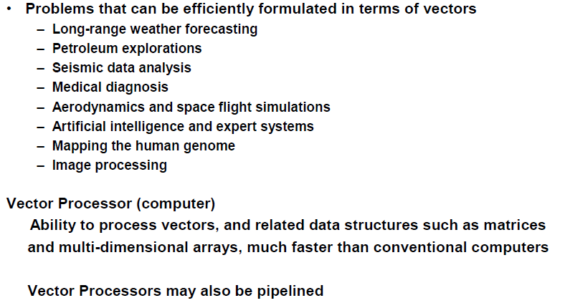
VECTOR PROCESSING APPLICATIONS
Based on M. Morris Mano “Computer System Architecture”-- Lecturer Ahmed Salah Hameed

Slide 4
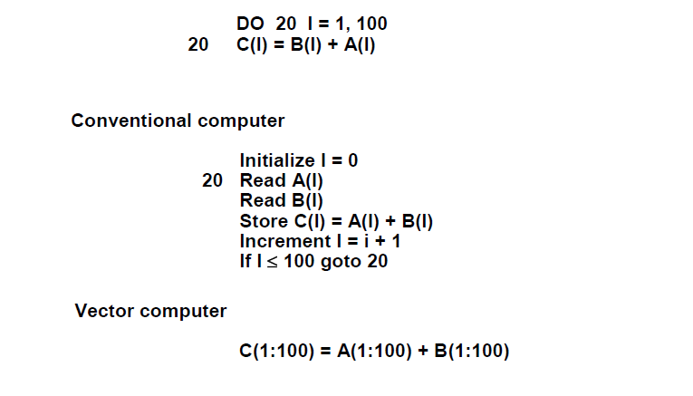
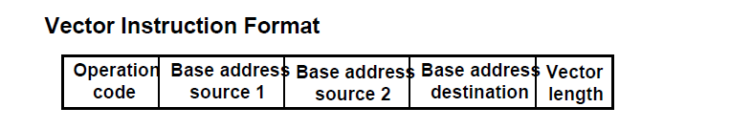
VECTOR PROCESSING APPLICATIONS
Based on M. Morris Mano “Computer System Architecture”-- Lecturer Ahmed Salah Hameed

Slide 5
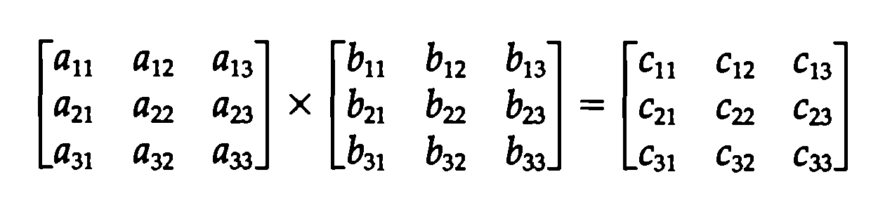
MATRIX MULTIPLICATION
The multiplication of two nxn matrices consists of n² inner products or n³ multiply-add operations.
Example: Product of two 3x3 matrices
c₁₁= a₁₁b₁₁+a₁₂b₂₁+a₁₃b₃₁
This requires 3 multiplications and 3 additions. The total number of multiply-add required to compute the matrix product is 9x3=27.
In general, the inner product consists of the sum of k product terms of the form
C = A₁B₁+A₂B₂+A₃B₃+…+A_{k} B_{k}
Based on M. Morris Mano “Computer System Architecture”-- Lecturer Ahmed Salah Hameed

Slide 6
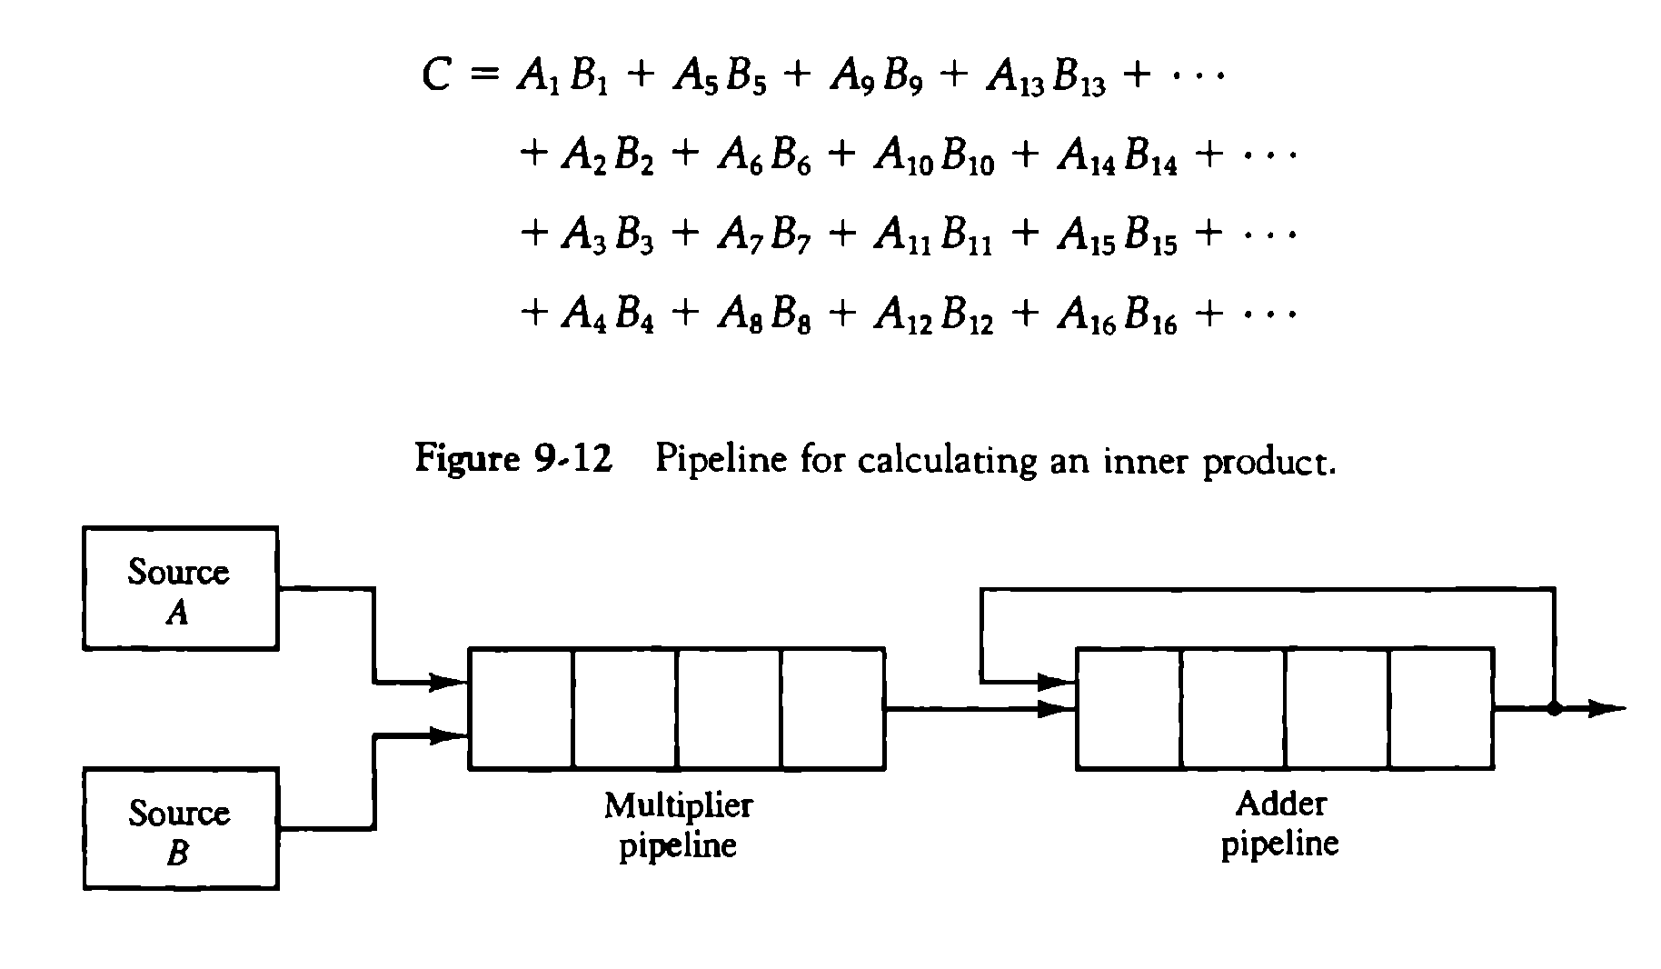
MATRIX MULTIPLICATION
Based on M. Morris Mano “Computer System Architecture”-- Lecturer Ahmed Salah Hameed

Slide 7
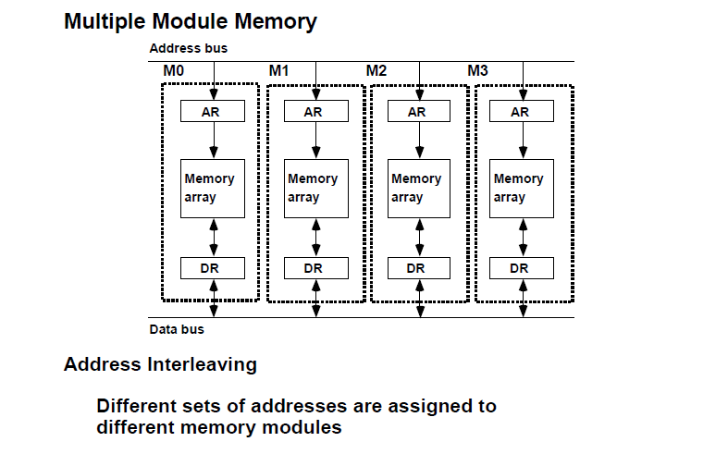
MEMORY INTERLEAVING
Based on M. Morris Mano “Computer System Architecture”-- Lecturer Ahmed Salah Hameed

Slide 8
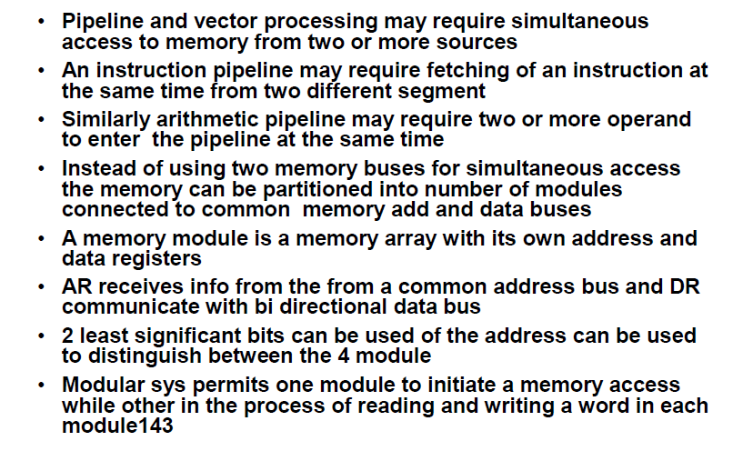
MEMORY INTERLEAVING
Based on M. Morris Mano “Computer System Architecture”-- Lecturer Ahmed Salah Hameed

Slide 9
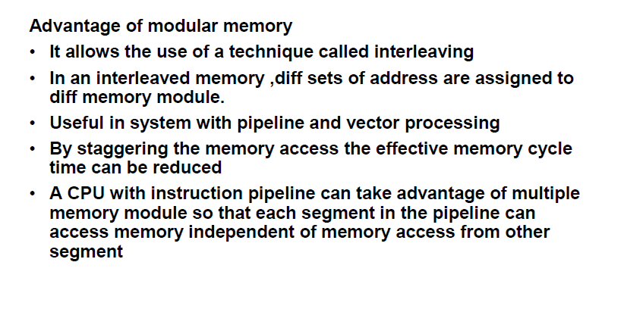
MEMORY INTERLEAVING
Based on M. Morris Mano “Computer System Architecture”-- Lecturer Ahmed Salah Hameed

Slide 10
MEMORY INTERLEAVING
1024 words
memory array 1 use addresses: 0, 4, 8, 12, …, 1020
Array 2: 1, 5, 9, 13, …, 1021
Array 3: 2, 6, 10, …, 1022
Array 4: 3, 7, 11, …, 1023
Based on M. Morris Mano “Computer System Architecture”-- Lecturer Ahmed Salah Hameed

Slide 11
SUPERCOMPUTERS
Supercomputer: A commercial computer with vector instructions and pipelined floating-point arithmetic operations.
Supercomputers are very powerful, high-performance machines used mostly for scientific computations.
To speed up the operation, the components are packed tightly together to minimize the distance that the electronic signals have to travel.
Supercomputers also use special techniques for removing the heat from circuits to prevent them from burning up because of their close proximity.
Based on M. Morris Mano “Computer System Architecture”-- Lecturer Ahmed Salah Hameed

Slide 12
SUPERCOMPUTERS
A measure used to evaluate computers in their ability to perform a given number of floating-point operations per second is referred to as flops.
The term megaflops is used to denote million flops and gigaflops to denote billion flops.
A typical supercomputer has a basic cycle time of 4 to 20 ns.
If the processor can calculate a floating-point operation through a pipeline each cycle time, it will have the ability to perform 50 to 250 megaflops.
Based on M. Morris Mano “Computer System Architecture”-- Lecturer Ahmed Salah Hameed

Slide 13
SUPERCOMPUTERS
In 1976 is the Cray-1 supercomputer with 12.5 ns clock cycle.
Cray research extended its supercomputer to a multiprocessor configuration called Cray X-MP and Cray Y-MP.
The new Cray-2 supercomputer is 12 times more powerful than the Cray-1 in vector processing mode.
Another early model supercomputer is the Fujitsu VP-200. It has a scalar processor and a vector processor that can operate concurrently. Like the Cray supercomputers, a large number of registers and multiple functional units are used to enable register-to-register vector operations. It can achieve up to 300 megaflops.
The newer VP-2600 uses a clock cycle of 3.2 ns and claims a peak performance of 5 gigaflops.
Based on M. Morris Mano “Computer System Architecture”-- Lecturer Ahmed Salah Hameed

Slide 14
ARRAY PROCESSORS
Array processor is a processor that performs computations on large arrays of data.
Two different types of processors
An attached array processor is an auxiliary processor attached to a general-purpose computer. It is intended to improve the performance of the host computer in specific numerical computation tasks.
An SIMD array processor is a processor that has a single-instruction multiple-data organization. It manipulates vector instructions by means of multiple functional units responding to a common instruction.
Based on M. Morris Mano “Computer System Architecture”-- Lecturer Ahmed Salah Hameed

Slide 15
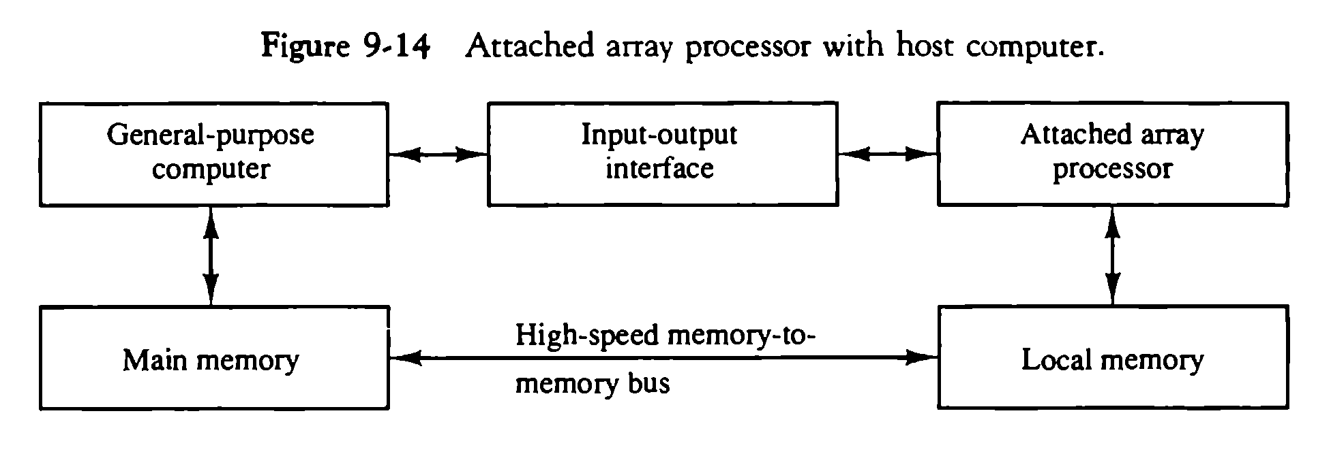
ATTACHED ARRAY PROCESSOR WITH HOST COMPUTER
Based on M. Morris Mano “Computer System Architecture”-- Lecturer Ahmed Salah Hameed

Slide 16
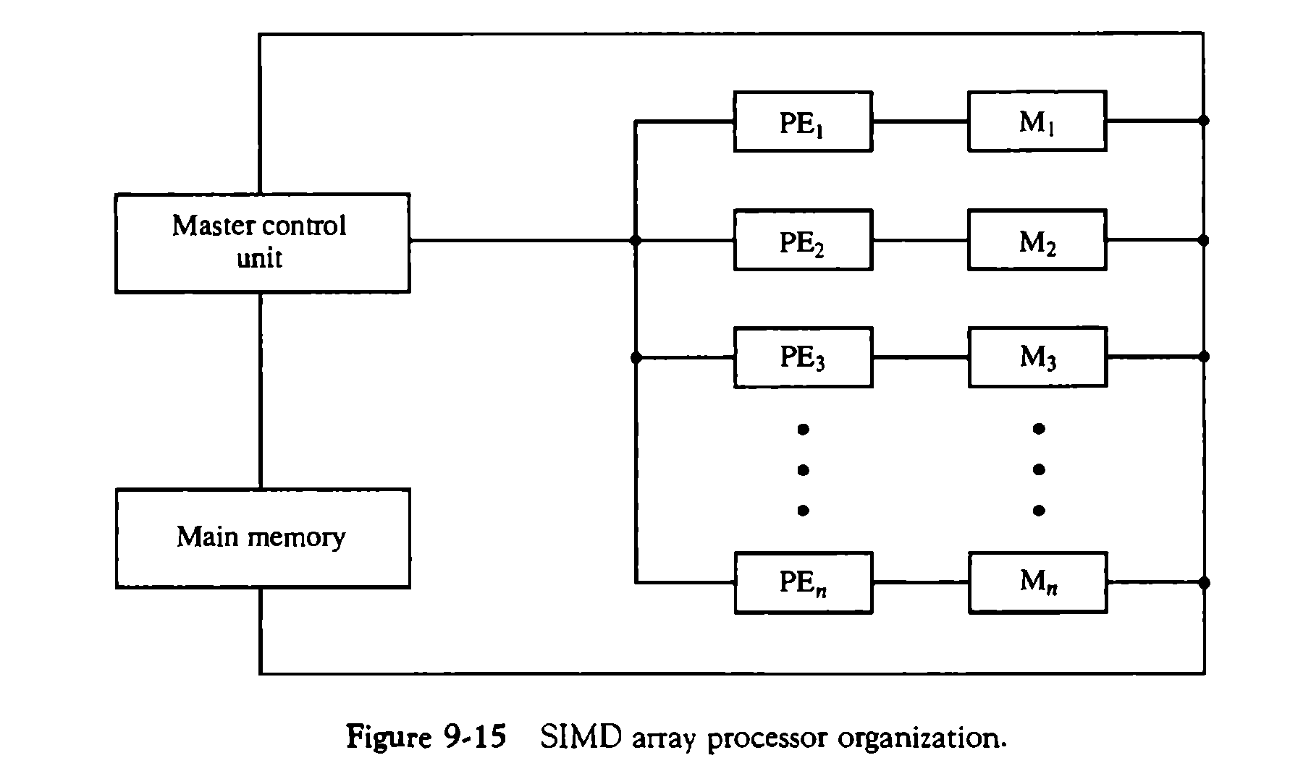
SIMD ARRAY PROCESSOR ORGANIZATION
Based on M. Morris Mano “Computer System Architecture”-- Lecturer Ahmed Salah Hameed

Slide 17
SIMD ARRAY PROCESSOR ORGANIZATION
Execution of the instruction
Example, the vector addition C = A + B.
The master control unit first stores the ith components ai and bi, of A and B in local memory Mi for i = 1, 2,3,..., n.
It then broadcasts the floating-point add instruction ci = ai + bi to all PEs, causing the addition to take place simultaneously.
The components of c, are stored in fixed locations in each local memory. This produces the desired vector sum in one add cycle.
Based on M. Morris Mano “Computer System Architecture”-- Lecturer Ahmed Salah Hameed

Slide 18
SIMD ARRAY PROCESSOR ORGANIZATION
Masking schemes
They are used to control the status of each PE during the execution of vector instructions.
Each PE has a flag that is set when the PE is active and reset when the PE is inactive. This ensures that only those PEs that need to participate are active during the execution of the instruction.
For example, suppose that the array processor contains a set of 64 PEs. If a vector length of less than 64 data items is to be processed, the control unit selects the proper number of PEs to be active. Vectors of greater length than 64 must be divided into 64-word portions by the control unit.
Based on M. Morris Mano “Computer System Architecture”-- Lecturer Ahmed Salah Hameed

Slide 19
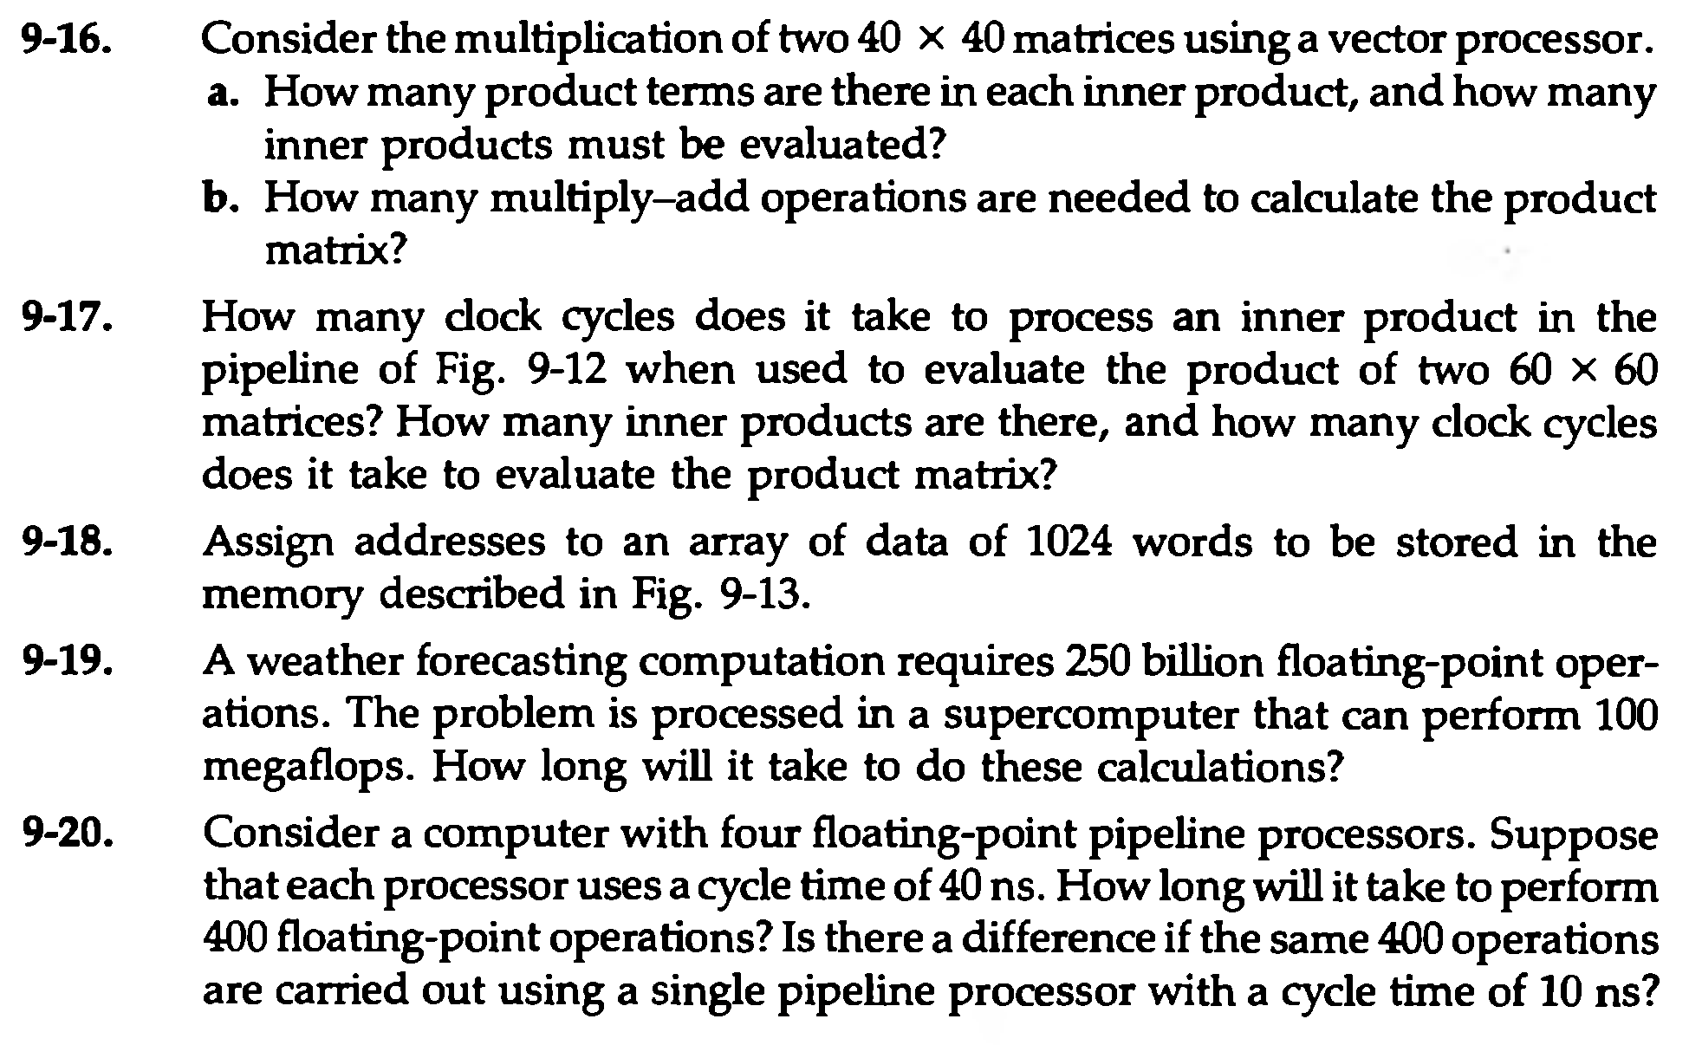

PROBLEMS
Based on M. Morris Mano “Computer System Architecture”-- Lecturer Ahmed Salah Hameed

Slide 20
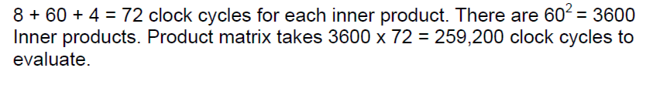
PROBLEMS
Based on M. Morris Mano “Computer System Architecture”-- Lecturer Ahmed Salah Hameed

Slide 21
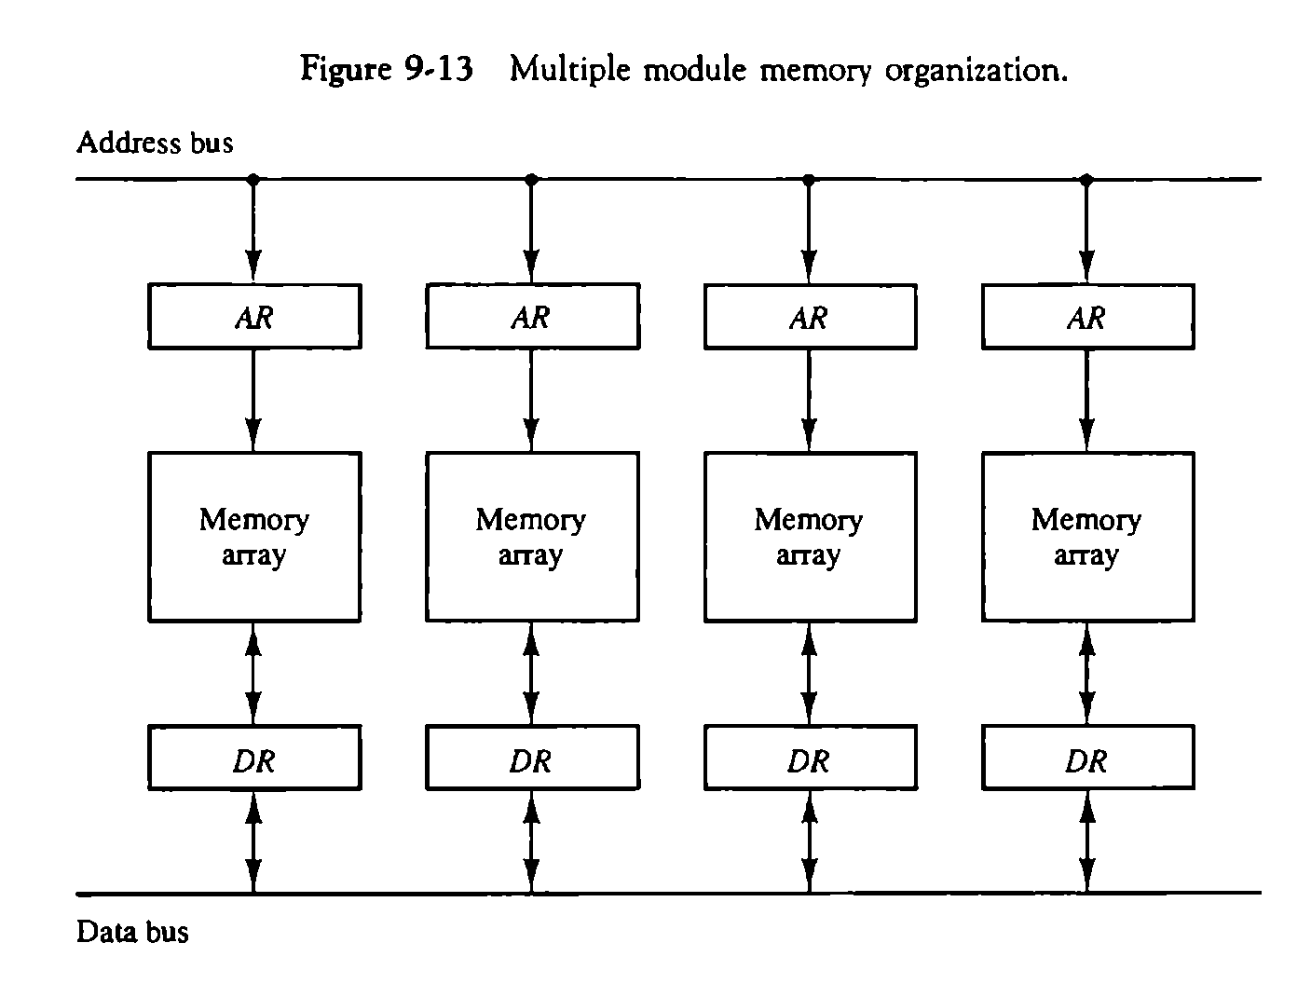
PROBLEMS
Based on M. Morris Mano “Computer System Architecture”-- Lecturer Ahmed Salah Hameed

Slide 22

PROBLEMS
Based on M. Morris Mano “Computer System Architecture”-- Lecturer Ahmed Salah Hameed

Slide 23
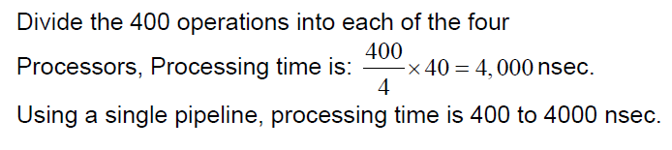
PROBLEMS
Based on M. Morris Mano “Computer System Architecture”-- Lecturer Ahmed Salah Hameed

